Slide 1
Agentic AI Hackathon: Building Intelligent Agents with IBM Granite and LangFlow

Slide 2

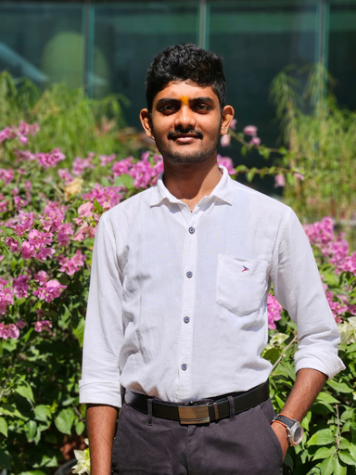

Team name: AgroSense
TEAM MEMBER NAME | Recent Passport Photo | Email ID | Phone number [WhatsApp]
Sreeharsha G Hegde |  | sreeharsha.bs23@bmsce.ac.in | 87623 28948
Vishwas Kumar S S |  | vishwaskumar.bs23@bmsce.ac.in | 9448762046
Kousthubha L Rao |  | kousthubhal.bs23@bmsce.ac.in | 93535 49005

Slide 3

Problem statement
Inefficient irrigation practices lead to water wastage, crop stress, and reduced productivity. Farmers often lack continuous insights into soil moisture dynamics and crop water requirements. Manual irrigation decisions may not adapt to changing weather and soil conditions. There is a need for an intelligent assistive system that can analyze irrigation-related data and support water-efficient farming practices.

Slide 4

Proposed solution
Multi-Agent Design
Soil & Weather Data Analysis Agent
Soil moisture levels
Rainfall & evapotranspiration
Crop growth stage context
Water Stress Detection Agent
Identifies over-irrigation / under-irrigation
Uses historical + seasonal baselines
Irrigation Advisory Assistant
Suggests irrigation timing & quantity
Focuses on water efficiency & sustainability

Slide 5
Why Irrigation Needs Intelligence
Manual irrigation decisions are reactive and inconsistent
Over-irrigation → water wastage & soil degradation
Under-irrigation → crop stress & yield loss
Farmers lack continuous, contextual insights combining:
Soil conditions
Weather variability
Crop growth stages

Slide 6

End user of project
Primary End Users
Farmers (small, medium, and large-scale)
Especially those practicing water-limited or rain-dependent agriculture
Users with access to basic soil and weather data (sensors or public sources)
Secondary Users
Agricultural extension officers
Support farmers with data-backed irrigation advice
Sustainable agriculture planners / NGOs
Monitor water-use efficiency trends across regions

Slide 7
Technology Used
Langflow platform
Langflow component name – Agent , Chat input , Chat output
IBM Granite model (ibm-granite-3-2-8b)
IBM Cloud
RAG
IBM Watsonx.ai
Watsonx

Slide 8
Novelty and Uniqueness
Assistive AI, not Automation
Provides recommendations only, keeping farmers in full control
Builds trust and avoids risk from fully automated irrigation systems
Agent-Based Reasoning Architecture
Separate agents for data analysis, stress detection, and advisory
Enables clearer explanations and modular decision-making
Context-Aware Irrigation Insights
Combines soil moisture + weather + crop growth stage
Moves beyond threshold-based irrigation rules
Knowledge-Grounded Intelligence (RAG)
Verified irrigation guidelines
Sustainable water management frameworks
Reduces hallucination and improves reliability
Designed for Resource-Constrained Farming
Works with minimal sensors and public weather data
Scalable from small farms to larger deployments

Slide 9
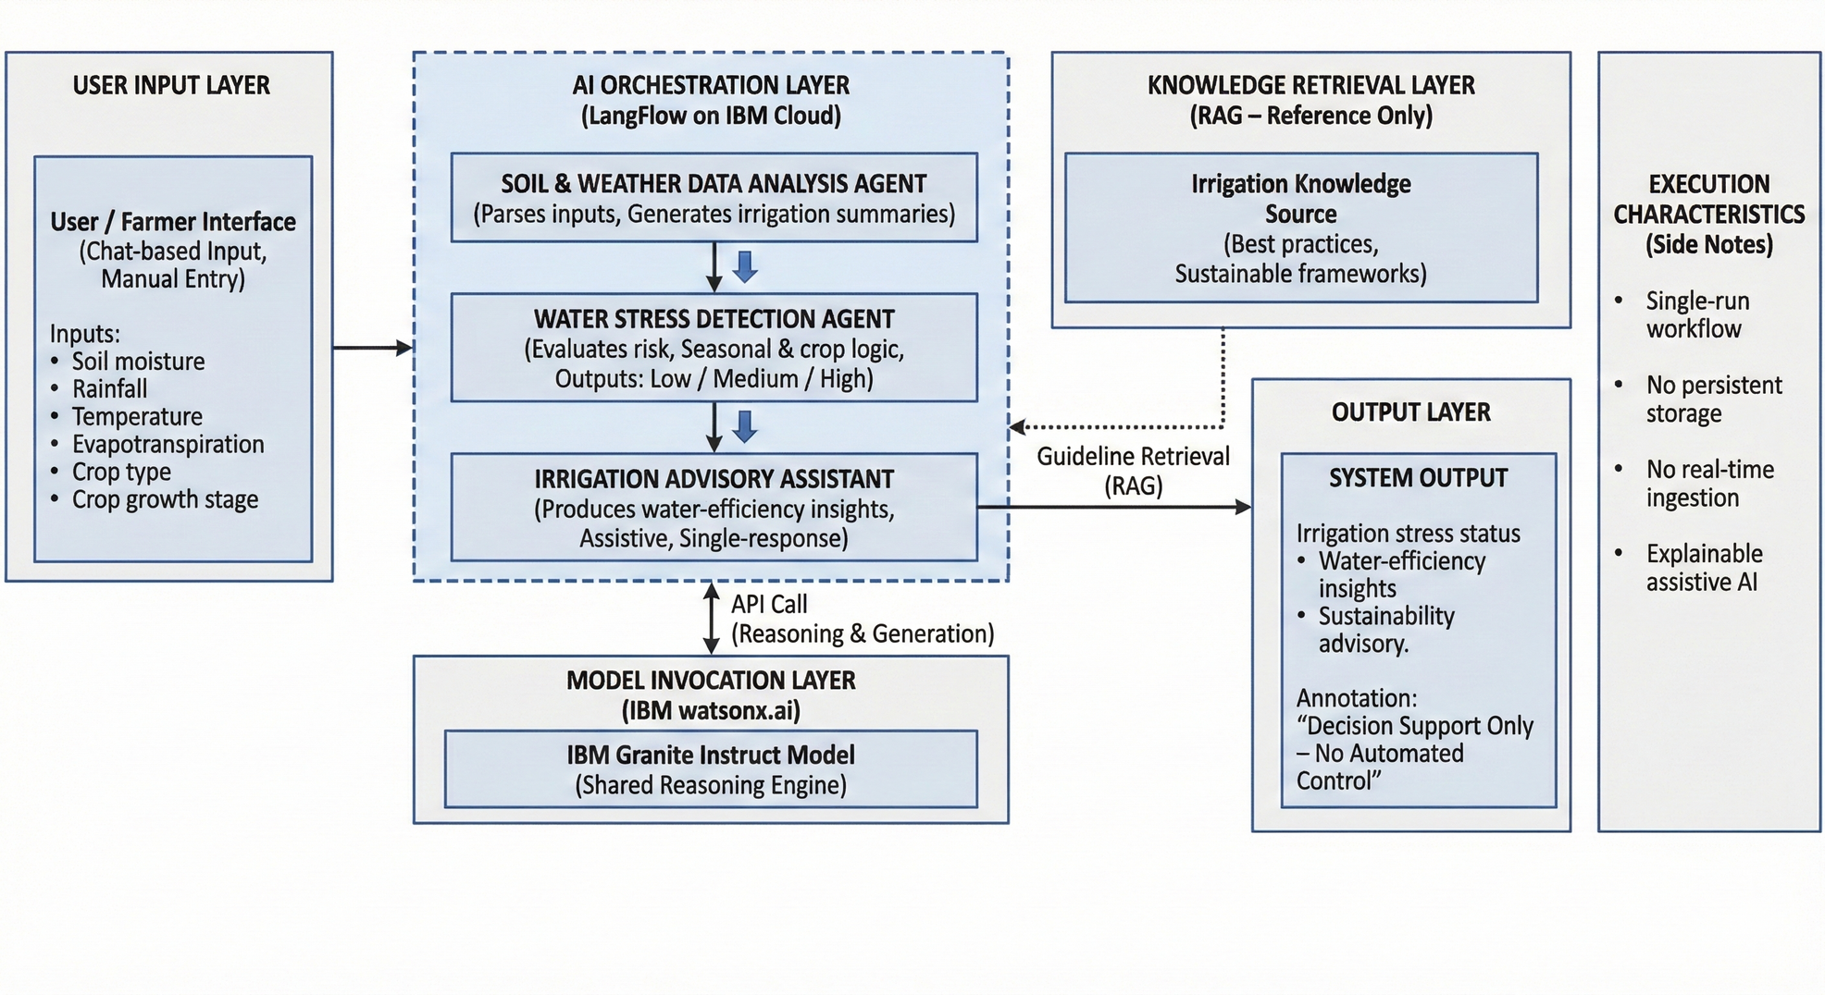
Technical flow diagram - Architecture blueprint

Slide 10
Langflow components Used
Chat Input – Ingests soil, weather, and crop-related data for analysis
Multi-Agent Nodes – Modular agents for data analysis, stress detection, and irrigation advisory
IBM Granite Model – Powers reasoning and explainable insights across all agents
Mock Data (RAG Source) – Provides grounded irrigation and sustainability guidelines
Tool Mode – Enables controlled knowledge retrieval for advisory generation
Agent Chaining – Ensures structured flow from analysis to decision support
Chat Output – Delivers clear, assistive irrigation insights to users

Slide 11
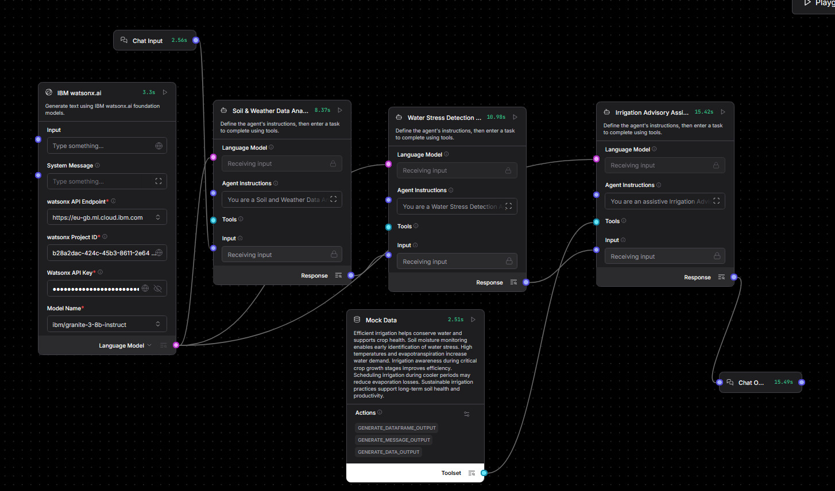
Input Screenshot 1

Slide 12
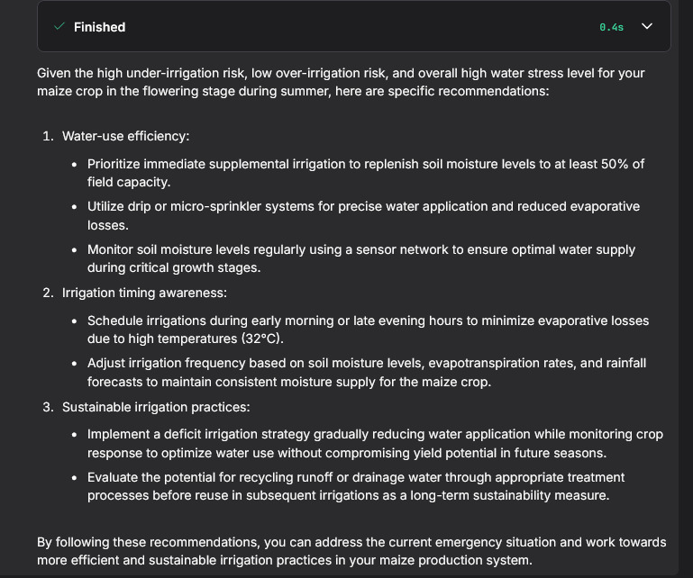
Output Screenshot 1

Slide 13
Future Scope
Expanded Data Sources
Integration with satellite imagery and remote sensing
Real-time IoT sensor networks for higher precision
Advanced Intelligence
Predictive irrigation planning using seasonal forecasts
Personalized models for specific crops and soil types
Scalability & Adoption
Regional dashboards for cooperatives and policymakers
Multilingual support for wider farmer accessibility
Sustainability Enhancements
Carbon- and water-footprint tracking
Alignment with climate-resilient farming practices

Slide 14
Git Hub Link
https://github.com/Shreeharshahegde0203/AI-Assisted-Precision-Irrigation-Monitoring-System

Slide 15
References
1. Central Soil Salinity Research Institute – Irrigation Best Practices https://www.cssri.res.in/irrigation-management/
2. Indian Council of Agricultural Research (ICAR) – Precision Farming https://icar.org.in/content/precision-farming
3. Ministry of Jal Shakti – National Water Mission https://nwm.gov.in/
4. Central Water Commission – Water Management Manuals https://cwc.gov.in/
5. CRIDA (Central Research Institute for Dryland Agriculture) – Soil & Water Management https://crida.in/soil-water-management/
6. NABARD – Water Use Efficiency Reports https://www.nabard.org/content1.aspx?id=592&param=page
7. Ministry of Agriculture & Farmers Welfare – Package of Practices https://agricoop.nic.in/en/PackageOfPractices
8. India Meteorological Department (IMD) – Weather Data & Alerts https://mausam.imd.gov.in/
9. CWC-IWR (Central Water Commission – Integrated Water Resources) https://cwc.gov.in/water-resources
10. Watershed India – Sustainable Irrigation & Water Use FAO — Irrigation and Water Management https://www.fao.org/land-water/water/water-management/irrigation/en/

Slide 16


